Slide 1






Slide 2



Team Members
Mai Zakaria
Ebtsam Mohamed

Slide 3


Conncet 4 Game
Group Code: CAI1_SWD3_G1e

Slide 4
Project
Overview

Slide 5



Intoduction
We developed a web-based Connect4 game to apply front-end development principles. This game allows users to play the classic Connect4 game directly from their browsers using modern web technologies.

Slide 6
Objectives
Our primary objective was to build an interactive, user-friendly web application where players can enjoy the Connect4 game. The game is designed to enhance engagement through a clean interface and responsive design, while also showcasing our understanding of HTML, CSS, Bootstrap, and JavaScript.

Slide 7
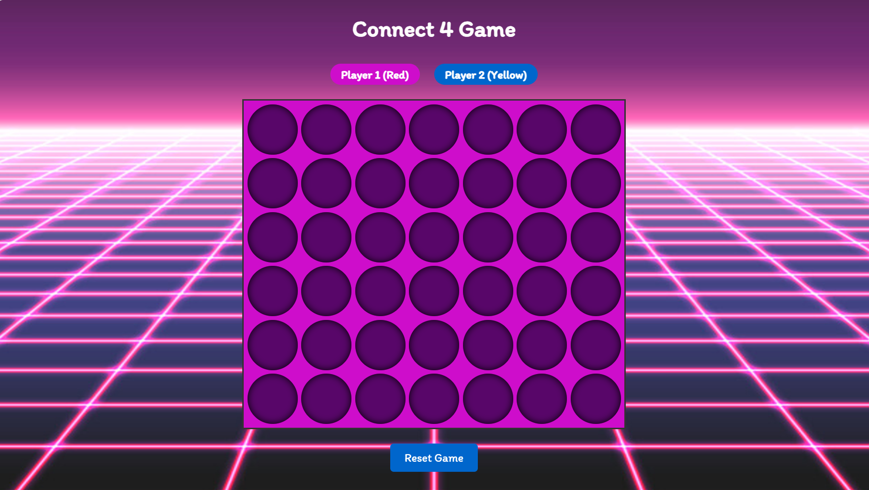
Features
The game includes a user-friendly interface, turn-based gameplay, win/lose detection, and a reset button to start a new game.

Slide 8
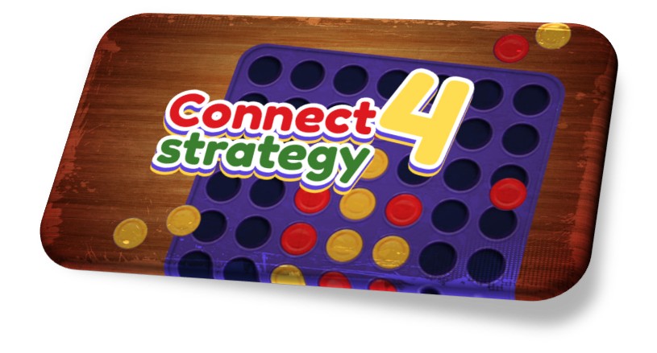
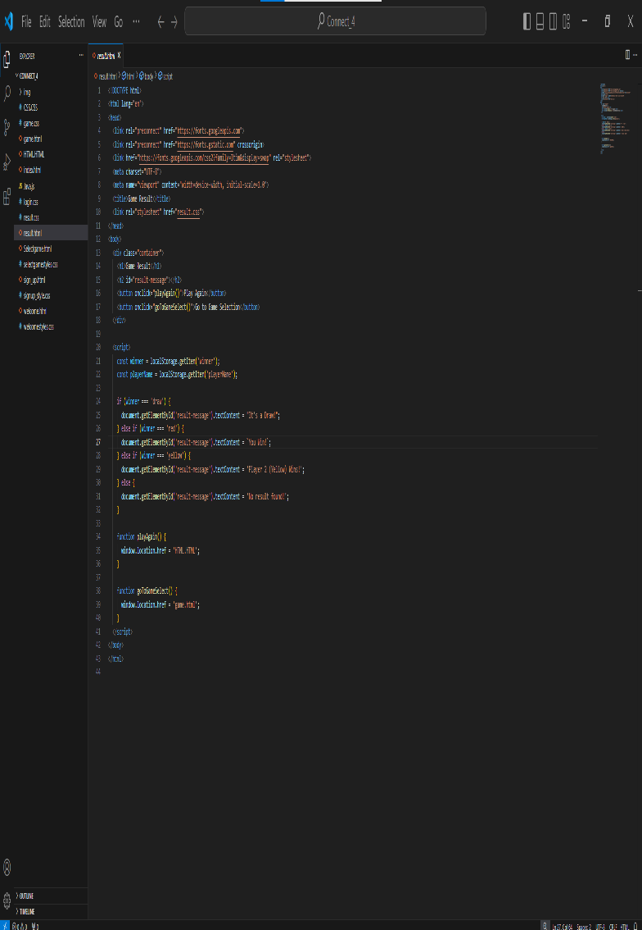
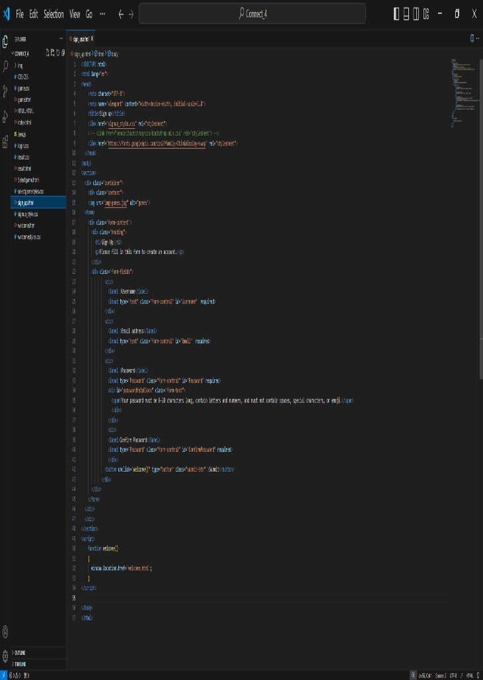
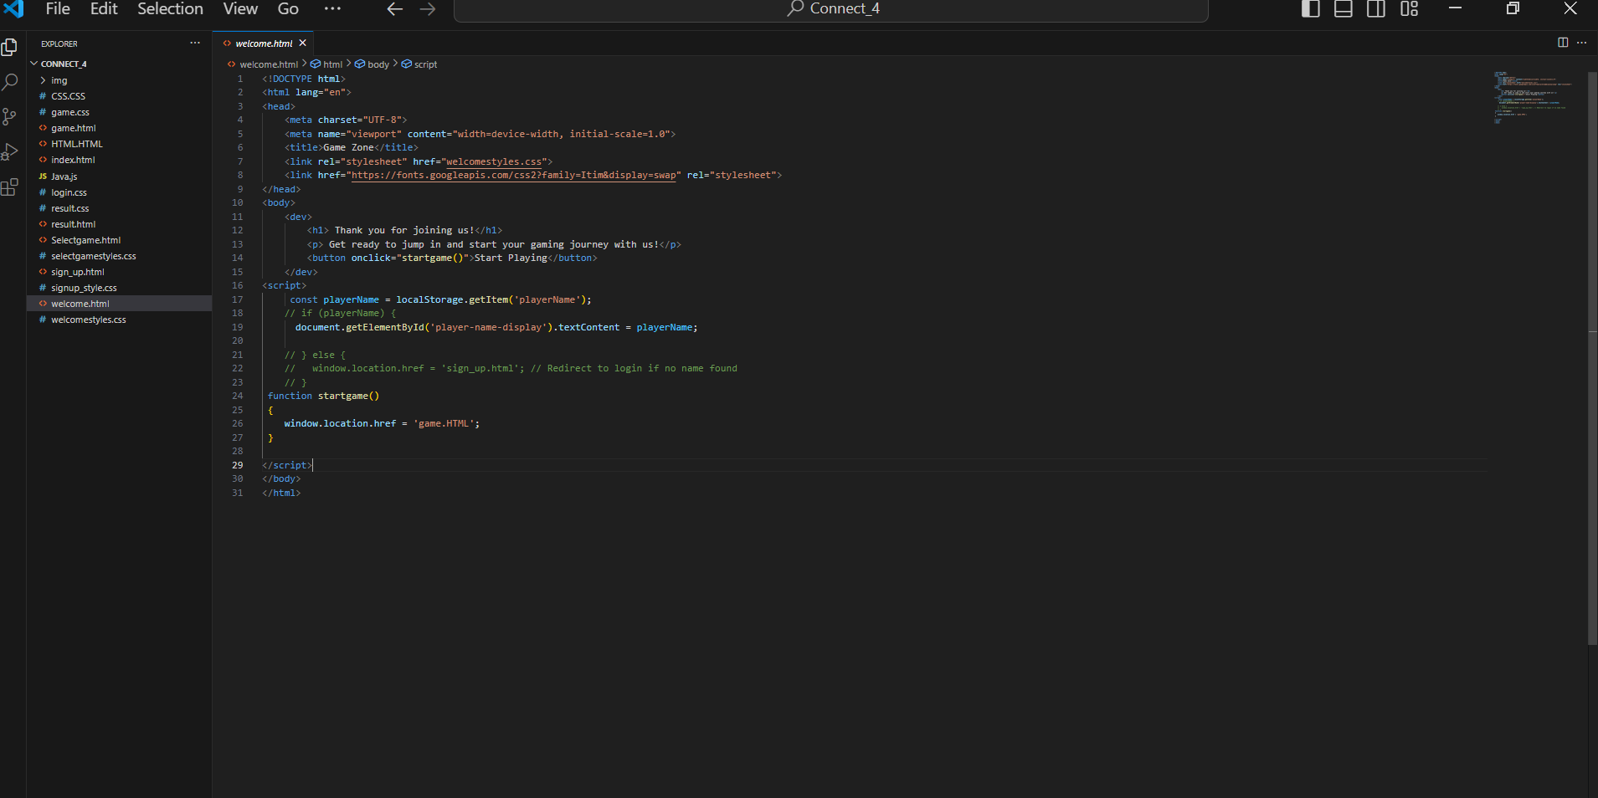
Key features and functionality
Strategic Thinking:
Develops skills in planning and strategy.
Gameplay:
Players aim to connect four of their pieces in a row ( Vertically or Horizontally or Diagonally)
Preventing Opponent:
Players must also block their opponent from achieving the same goal

Slide 9
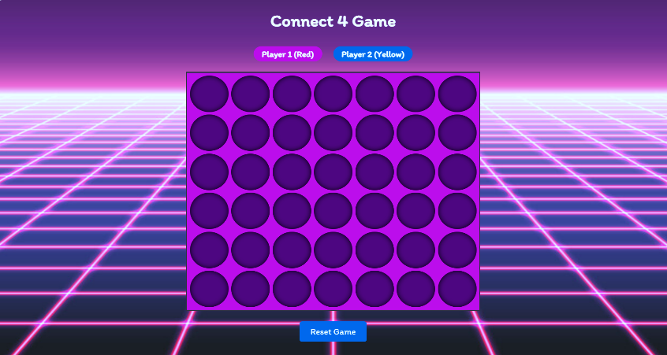
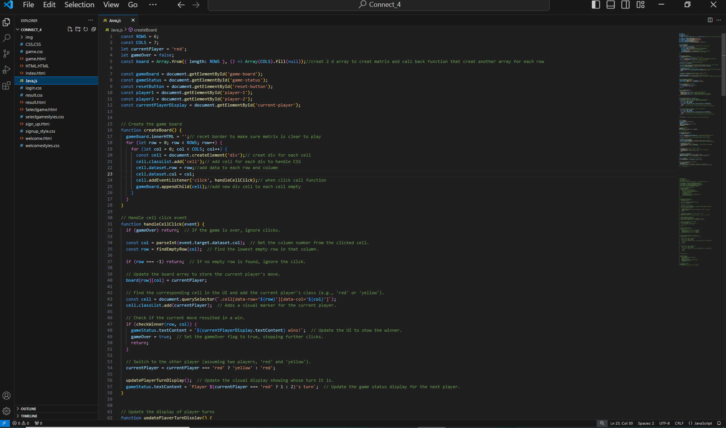
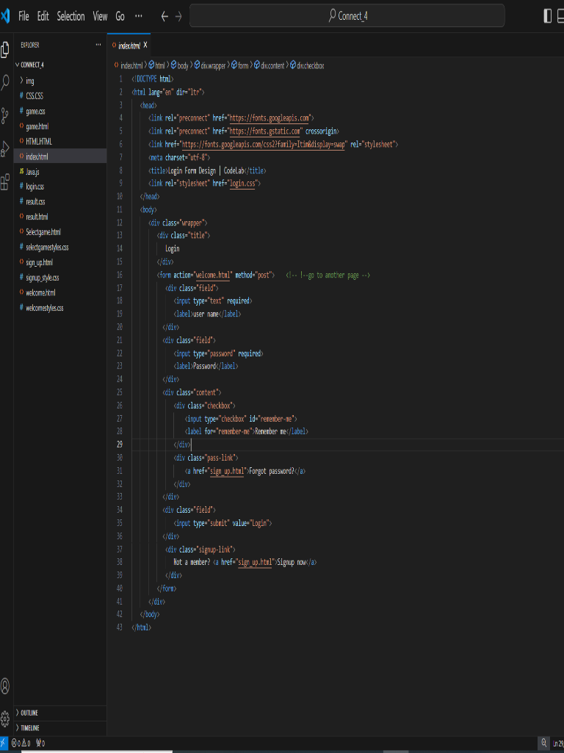
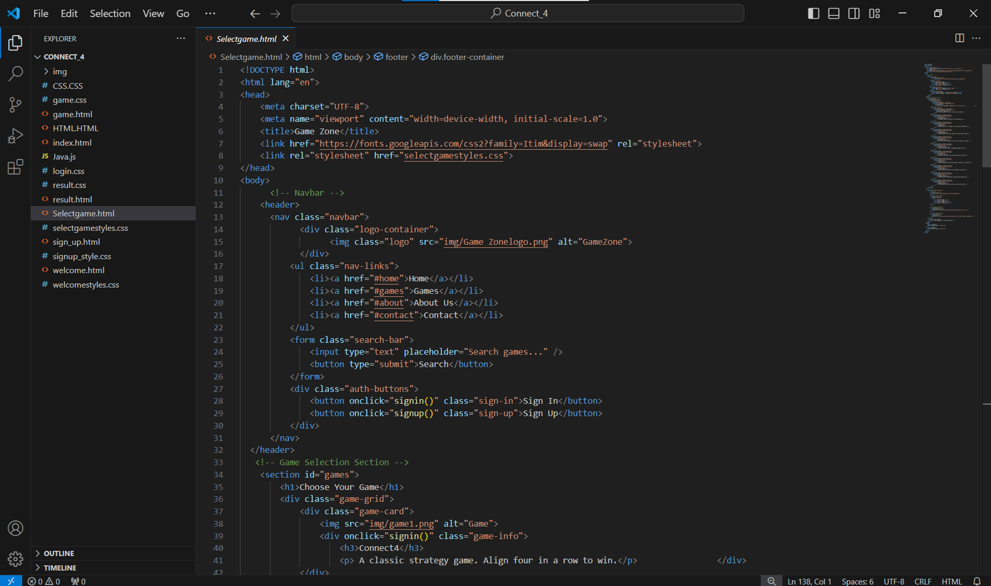
.Skills Enhanced:
Improves focus and decision-making abilities.
Teaches anticipation of the opponent’s moves.
Encourages thinking several steps ahead.
.Competitive Fun:
Provide engaging and enjoyable experience for players.
Feel free to ask if you need more information!

Slide 10
Project Details

Slide 11
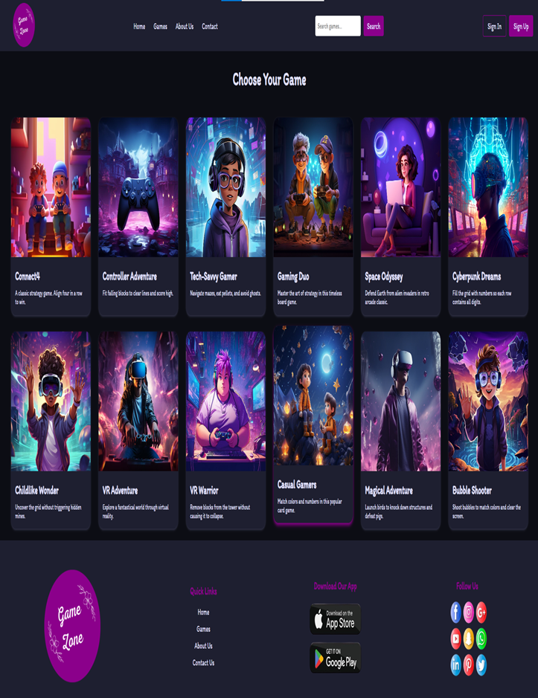
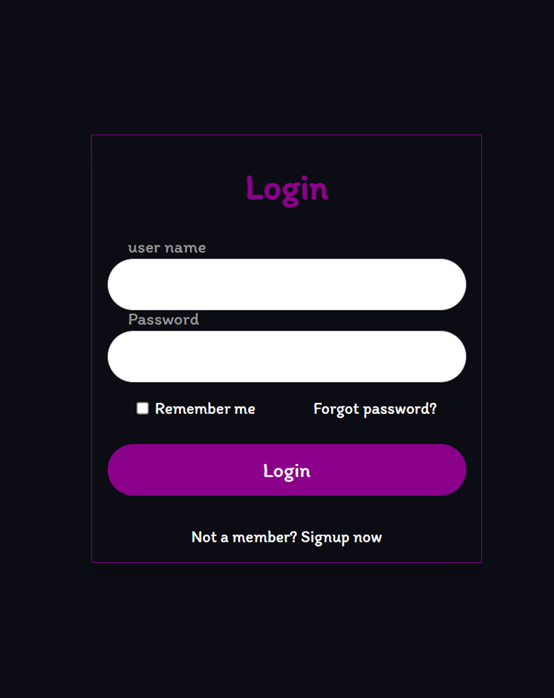
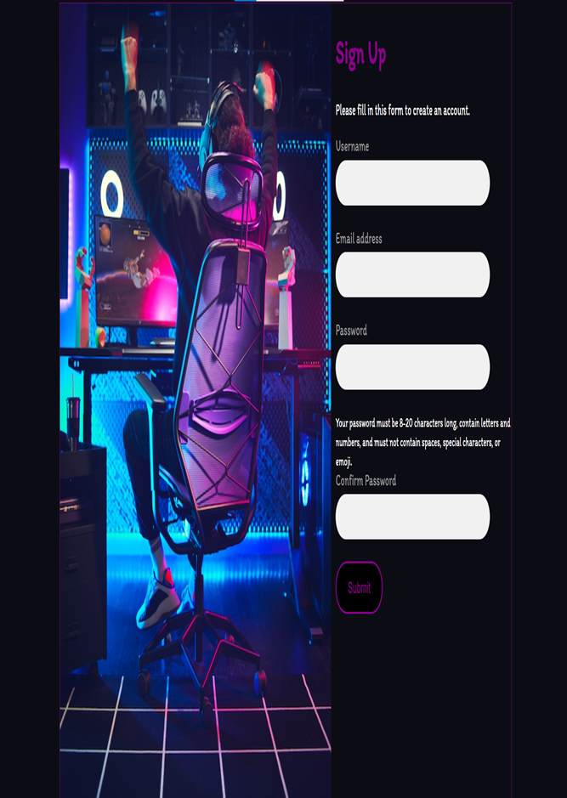
.User Interface
The game's interface was designed using HTML and CSS. Bootstrap was used for styling and responsiveness, ensuring the game looked great on different screen sizes.
Game Logic
The game logic, including turn management, disc placement, and win condition checks, was implemented using JavaScript.

Slide 12
Functionality
The game allows players to interact with the board, drop their discs, and receive feedback on the game's status.
User Experience
The focus was on providing a smooth and enjoyable gaming experience, with clear instructions and intuitive controls.

Slide 13
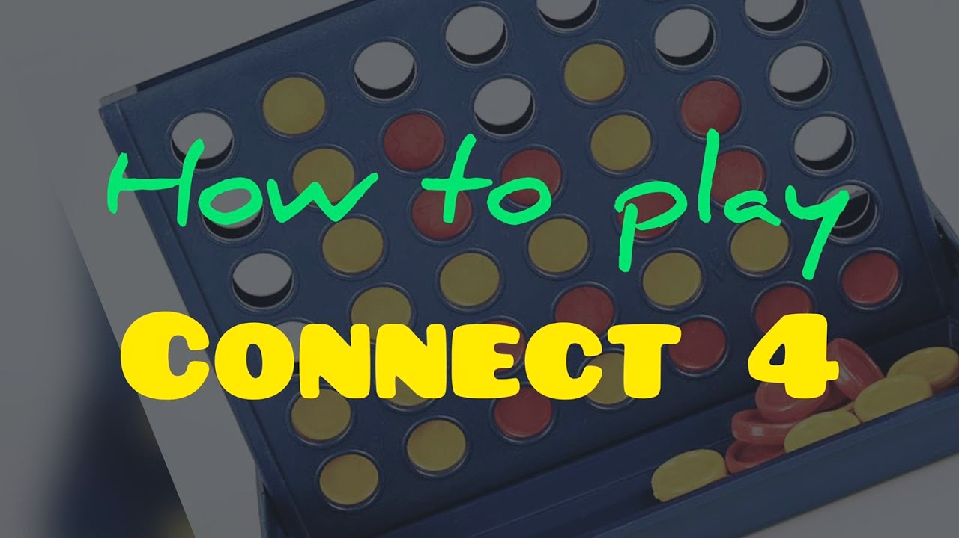

Here are the steps to start the Connect 4 game
Log in to any Internet browser
The appearance of the selection page Game
The login page will appear and the user will be asked to log in This is in the event that the user has account
In the event that the user does not have an account, the sign up page will appear, and account
The welcome page will appear
The Connect 4 game will appear
Finally, the result page appears to the user

Slide 14





01
02
Technology Stack
03
04

Slide 15
Final Results

Slide 16



select page
login page
signup page

Slide 17
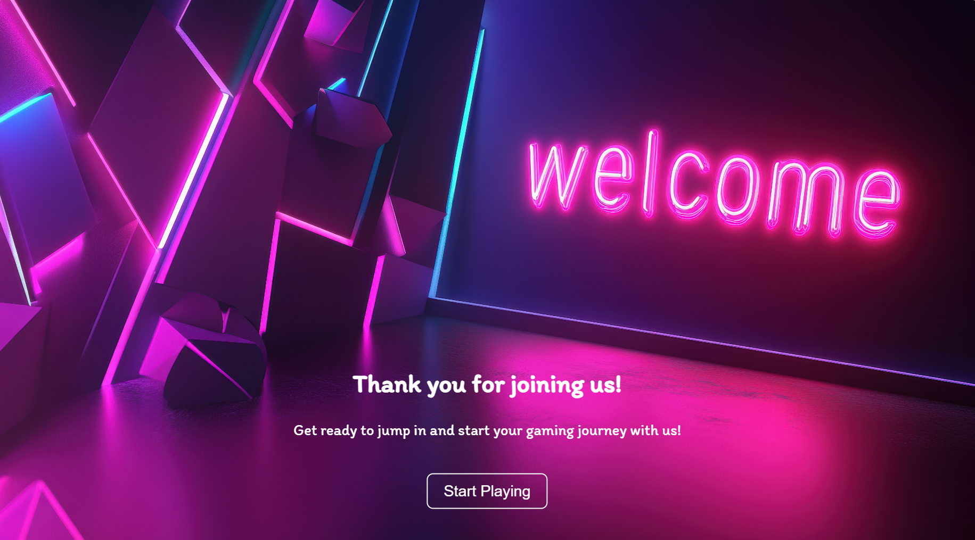


welcome page
connect 4 game
result page

Slide 18



Challenges and Solutions
Challenges
Solutions

Slide 19
Conclusion
This project allowed us to apply our front-end development skills to create a fun and interactive web game. We are grateful for the opportunity provided by the Digital Egypt Pioneers initiative and thank our mentors and teammates for their support.

Slide 20


Q&A
Thank you for your attention.
We are now open to any questions you may have about the project or its development process.

Slide 21
Thank you

